Slide 1

The Real Screenie Meanie
HATING MOVIES IS WHAT WE LOVE

Slide 2
Team 5
Dévi Hall
Brian Geertsma
Kevin
Francisco Ferré

Slide 3
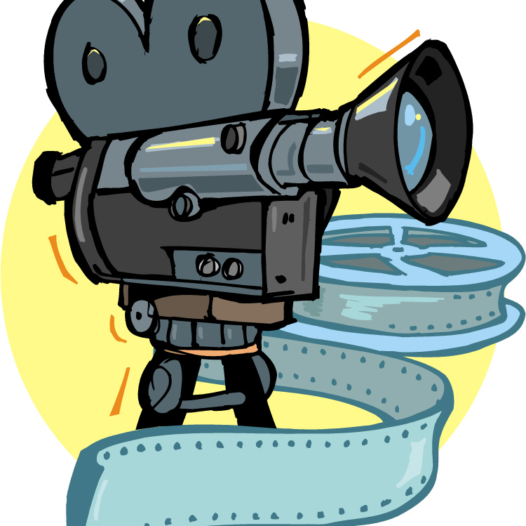
USER STORY
Have you ever seen a movie and thought… “Why? Why do they get to just make that and call it film?”
I know we have… but what if there was a place that encouraged criticism of film? We’re not talking official ratings or professional critics.
What if you can have a place to rant about films you hate while defending films you love?

Slide 4
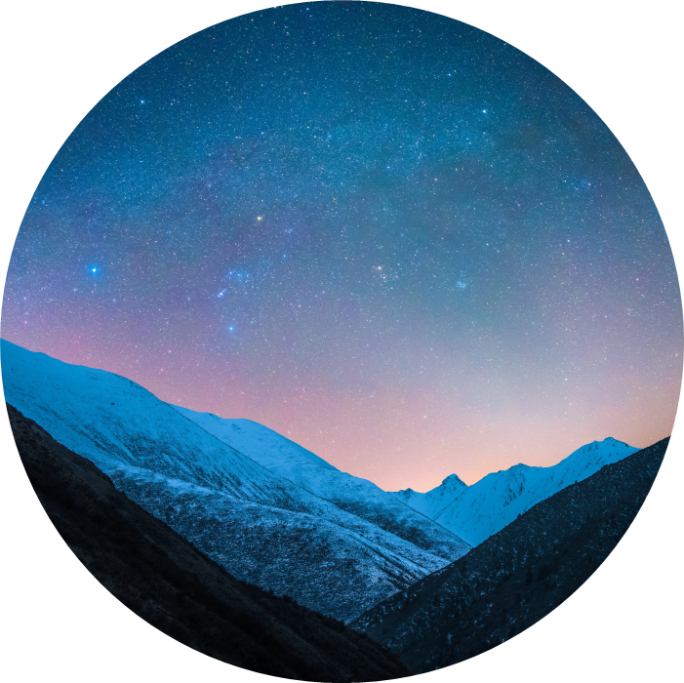
ELEVATOR PITCH
Social media is the beating, tell-tale heart of tech, and we offer an app called “Screenie Meanie”!
With Screenie Meanie™, you can support or smash your favorite films all from your own secure account.

Slide 5
Title
Subtitle
Subtitle
Subtitle
Add text, images, art, and videos.
Add transitions, animations, and motion.
Save to OneDrive, to get to your presentations from your computer, tablet, or phone.
Open the Design Ideas pane for instant slide makeovers.
When we have design ideas, we’ll show them to you right there.
This PowerPoint theme uses its own unique set of colors, fonts, and effects to create the overall look and feel of these slides.
PowerPoint has tons of themes to give your presentation just the right personality.

Slide 6



Summary
With PowerPoint, you can create presentations and share your work with others, wherever they are. Type the text you want here to get started. You can also add images, art, and videos on this template. Save to OneDrive and access your presentations from your computer, tablet, or phone.

Slide 7
Demonstration

Slide 8




Thank you
Presenter name
Email address
Website

